Slide 1
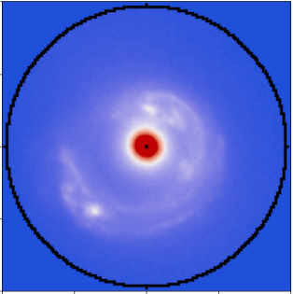
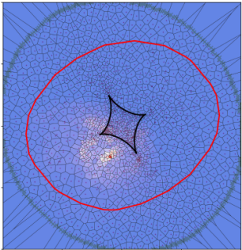
PyAutoFit: Classy Probabilistic Programming for Cosmology & Cancer
James Nightingale
Richard Hayes, Matthew Griffiths, Richard Massey
Amy Etherington, Qiuhan He, Xiaoyue Cao, Aristeidis Amvrosiadis, Andrew Robertson, Shaun Cole, Carlos Frenk, Ran Li

Slide 2
Overview
PyAutoFit & Probabilistic Programming:
What is probabilistic programming?
What is PyAutoFit?
Why PyAutoFit?
Cosmology & Cancer:
Where is the collaborative overlap?
Overview of the cancer model.
What are we developing together?

Slide 3
Probabilistic Programming

Slide 4
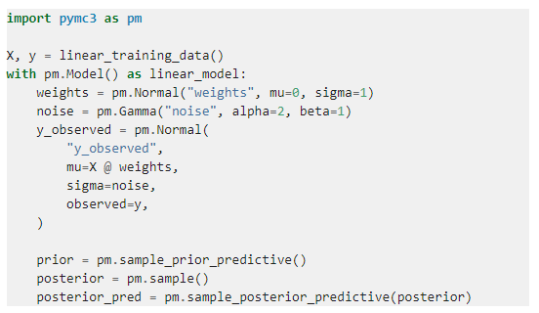
What is Probabilistic Programming?
Probabilistic programming languages (PPL) provide a framework that allows users to easily specify a probabilistic model and perform inference automatically.
There are a plethora of PPL’s available (e.g. PyMC3, STAN, Pyro).
All are suited to different problems, have different core features, etc.
They are some of the Github mega projects, so why on Earth are we developing our own PPL?

Slide 5
PyAutoFit: A PPL for Astronomers
Existing PPL’s were not suited to the model fitting challenges we faced when trying to model strong gravitational lenses, for example:
Fitting large and homogenous datasets with an identical model fitting procedure, with tools for processing the large libraries of results output.

Slide 6
PyAutoFit: A PPL for Astronomers
Existing PPL’s were not suited to the model fitting challenges we faced when trying to model strong gravitational lenses, for example:
Fitting large and homogenous datasets with an identical model fitting procedure, with tools for processing the large libraries of results output.
Problems where likelihood evaluations are expensive (e.g. run times of days per model-fit), necessitating highly customizable model-fitting pipelines with support for massively parallel computing.

Slide 7
PyAutoFit: A PPL for Astronomers
Existing PPL’s were not suited to the model fitting challenges we faced when trying to model strong gravitational lenses, for example:
Fitting large and homogenous datasets with an identical model fitting procedure, with tools for processing the large libraries of results output.
Problems where likelihood evaluations are expensive (e.g. run times of days per model-fit), necessitating highly customizable model-fitting pipelines with support for massively parallel computing.
Fitting many different models to the same dataset with tools that streamline model comparison.

Slide 8
PyAutoFit: A PPL for Astronomers
Existing PPL’s were not suited to the model fitting challenges we faced when trying to model strong gravitational lenses, for example:
Fitting large and homogenous datasets with an identical model fitting procedure, with tools for processing the large libraries of results output.
Problems where likelihood evaluations are expensive (e.g. run times of days per model-fit), necessitating highly customizable model-fitting pipelines with support for massively parallel computing.
Fitting many different models to the same dataset with tools that streamline model comparison.
PyAutoFit: highly customizable model-fitting software, for big data challenges in the many model regime.

Slide 9
PyAutoFit: Classy Interface

Slide 10
PyAutoFit
GitHub: https://github.com/Jammy2211/PyAutoLens Readthedocs: https://pyautolens.readthedocs.io/en/latest/ JOSS paper: https://joss.theoj.org/papers/10.21105/joss.02550 Binder: https://mybinder.org/v2/gh/Jammy2211/autofit_workspace/HEAD
Open source project actively seeking new users!
Documentation includes the HowToFit Jupyter notebook lectures, which teach new users how to compose and fit a model (aimed at undergraduates).

Slide 11
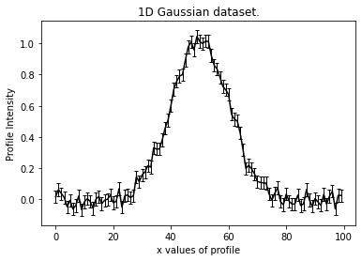
PyAutoFit: Classy Probabilistic Programming
Illustrative example, fitting noisy 1D data of a Gaussian.
Aim: use PyAutoFit to fit a Gaussian to the dataset via a non-linear search.

Slide 12
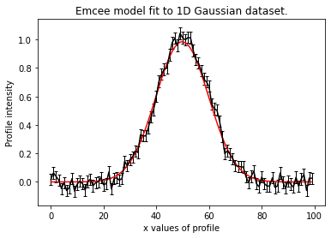
PyAutoFit: Classy Probabilistic Programming
Illustrative example, fitting noisy 1D data of a Gaussian.
Aim: use PyAutoFit to fit a Gaussian to the dataset via a non-linear search.

Slide 13
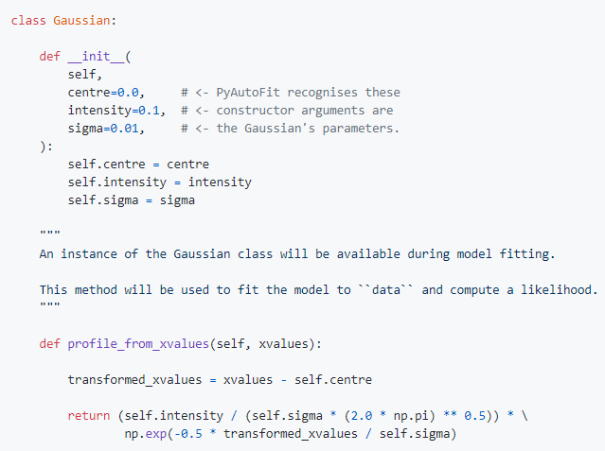
PyAutoFit: Classy Probabilistic Programming
Illustrative example, fitting noisy 1D data of a Gaussian.
Write a Python class to define the model component.

Slide 14
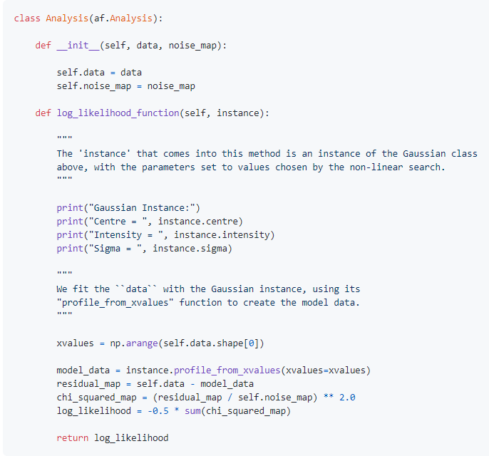
PyAutoFit: Classy Probabilistic Programming
Illustrative example, fitting noisy 1D data of a Gaussian.
Write a Python class to define the model component.
Write an Analysis class with the data and likelihood function.

Slide 15
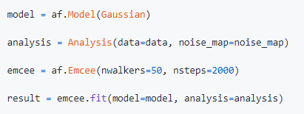
PyAutoFit: Classy Probabilistic Programming
Illustrative example, fitting noisy 1D data of a Gaussian.
Write a Python class to define the model component.
Write an Analysis class with the data and likelihood function.
Combine with your favourite non-linear search to fit the model to the data.

Slide 16
PyAutoFit: Classy Probabilistic Programming
Illustrative example, fitting noisy 1D data of a Gaussian.
Aim: use PyAutoFit to fit a Gaussian to the dataset via a non-linear search.

Slide 17
PyAutoFit: Composition &
Customization

Slide 18
Python Classes
The use of Python Classes to define the model, analysis and non-linear searches has downsides relative to other PPLs:
It is a less concise interface.
It requires a basic understanding of Python classes and object oriented programming (albeit good documentation can alleviate this).
The benefit is it provides a far more customizable model-fitting experience.

Slide 19
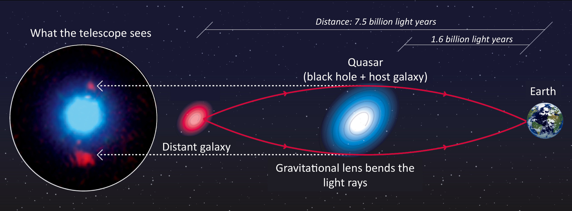
Model Composition (Strong Lensing Example)

Slide 20
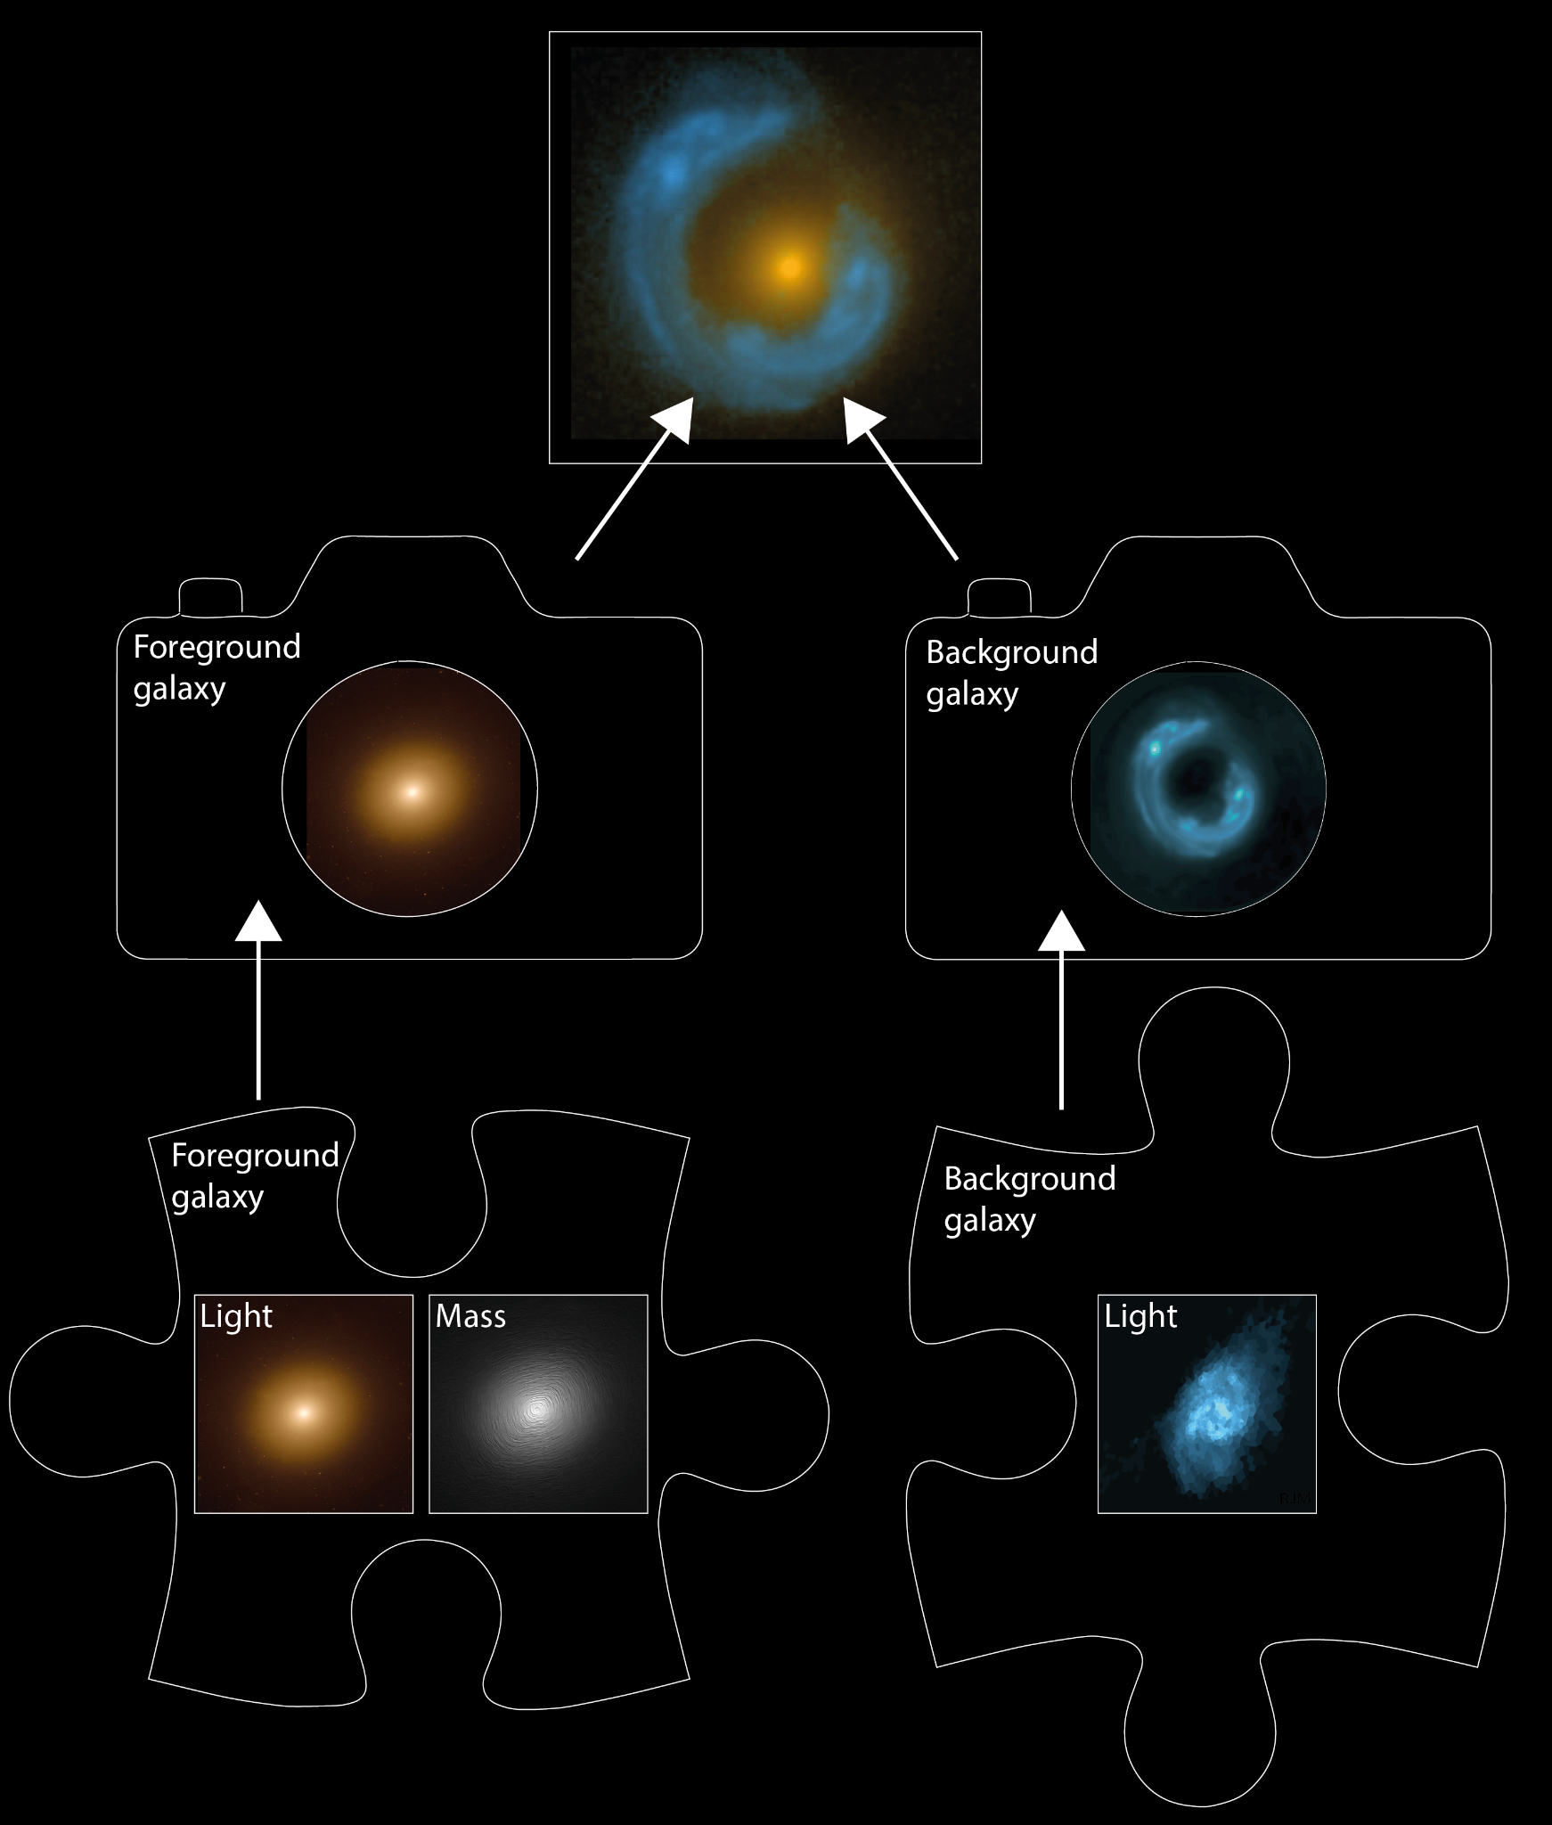
Model Composition
Break strong lens system into different model components:
Lens Galaxy: Light + Mass
Source Galaxy: Light

Slide 21
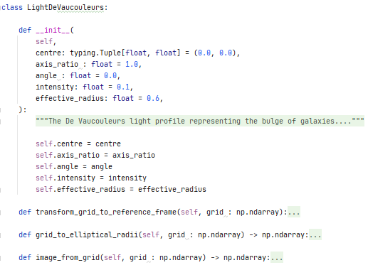
Light and Mass Profile classes
Light Profile:
Write the model components of the problem as Python classes using the same API shown previously.
Note how the model specific calculations of this problem are functions of the classes.

Slide 22
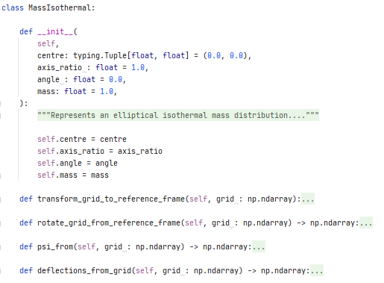
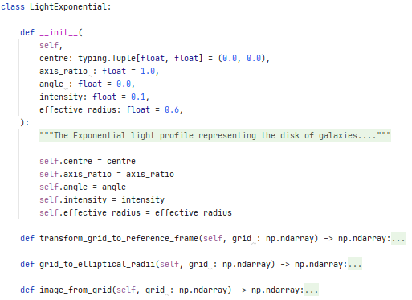
Light and Mass Profile classes
Mass Profile: Light Profile:

Slide 23
Model Composition
Break strong lens system into different model components:
Lens Galaxy: Light + Mass
Source Galaxy: Light

Slide 24
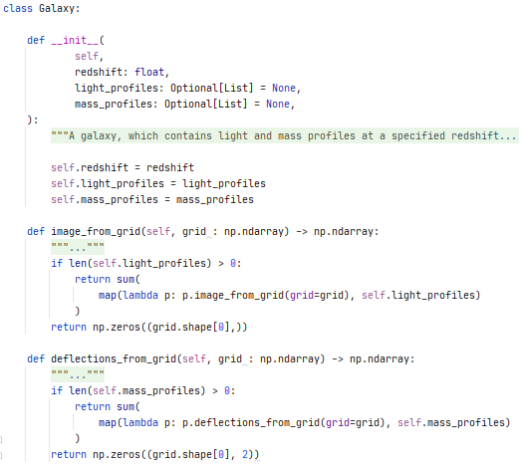
Galaxy Class
Combine the mass and light profiles at a specific redshift to make the lens galaxy and source galaxy.
Note how the image_from_grid and deflections_from_grid methods are included, which use the methods of the individual light and mass profiles.

Slide 25
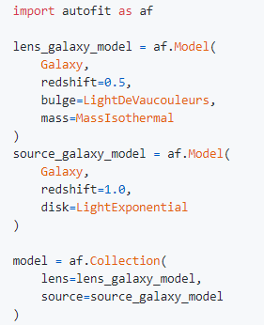
Composing the Model
Scans every light and mass profile to determine this model has 16 free parameters that the non-linear search fits.
A user can easily extend the model with more light profiles, mass profiles, etc.
This is the API a user of your model-fitting software is greeted with!

Slide 26
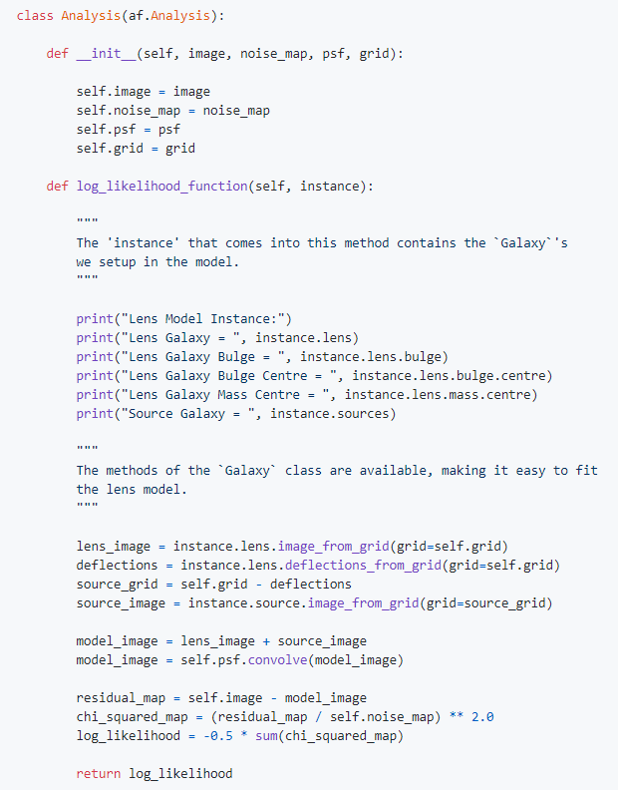
Customizing the Analysis
By using Python classes as the model components, this means we can write a concise likelihood function.
Cleanly separate the model-specific code (e.g. light profiles, mass profiles, lensing) from the model-fitting code.
Easy to extend and customize the Analysis class for bespoke model-fitting.

Slide 27
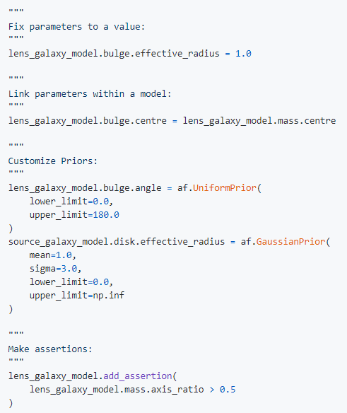
Customizing the Model
Full customization of the model parameterization, priors and valid regions of parameter space.
Default priors can be specified in easy to set up configuration files, so a new user does not need to ‘think’ about them.

Slide 28
On The Fly Visualization
The Analysis class can be extended or provide model-specific on-the-fly visualization of the model-fit so far.
Uses the maximum likelihood model of the search so far.
For long model-fits can inform you if the fitting has gone wrong early.

Slide 29
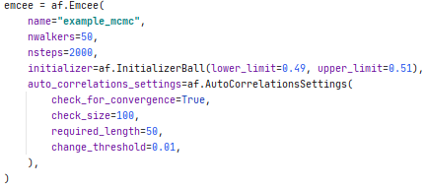
Customizing the Search
PyAutoFit supports many non-linear searches (MCMC, nested sampling, optimizers, etc.).
Full customization of their settings.
Defaults to configuration file values if not specified.

Slide 30
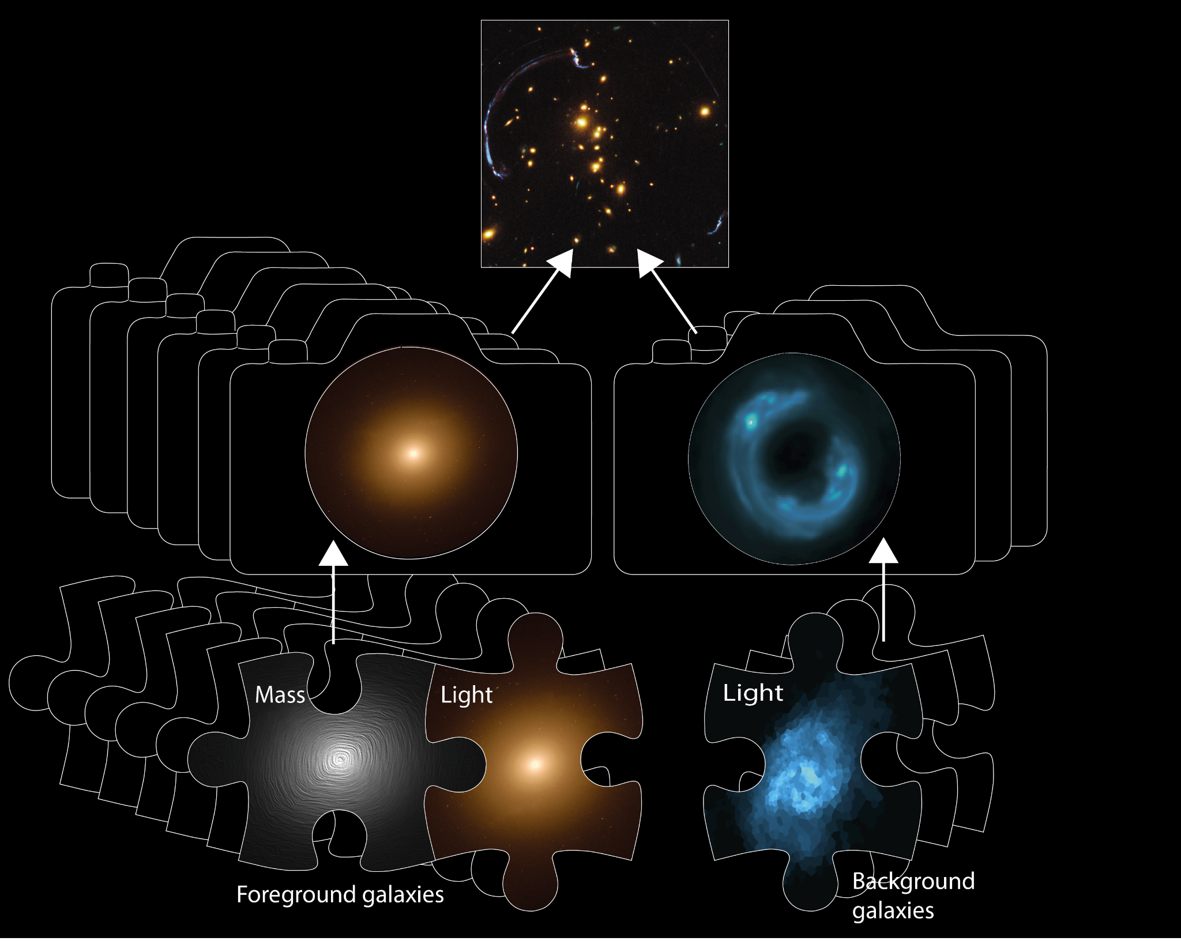
Model Composition
Straightforward for complex models to be composed and fitted in a scalable and streamlined way:
Easy to extend model galaxies with many light and mass profiles.
Or extend the model with many more galaxies.

Slide 31
Advanced Features
Database: output model-fitting results using a unique identifier to a queryable sqlite database to enable large-scale model-fitting to big datasets.
Search Grid Search: Massively parallel grid searches of non-linear searches.
Search Chaining: Write highly customizable model-fitting pipelines that chain together multiple non-linear searches.
Sensitivity Mapping: Simulating and fit many datasets to determine when a more complex model would be accept via model comparison.

Slide 32
PyAutoFit: Cosmology &
Cancer

Slide 33
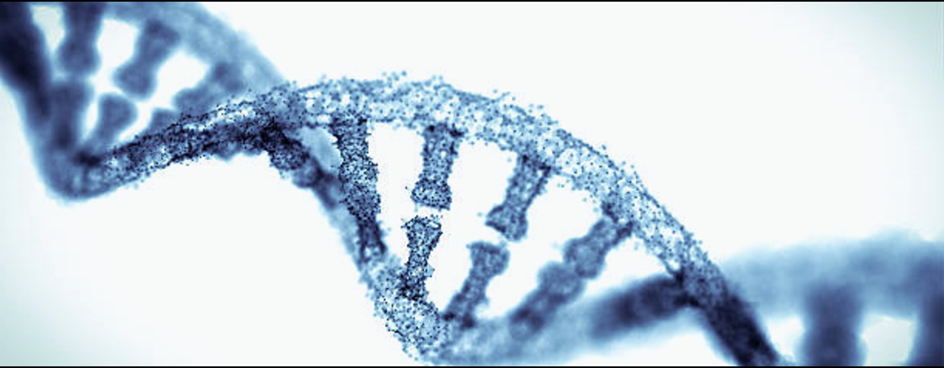
ConcR
Deep Science Ventures Biotech company
https://www.concr.co/
STFC Opportunities Grant and Innovate UK grant with Roche, UCL and others.

Slide 34
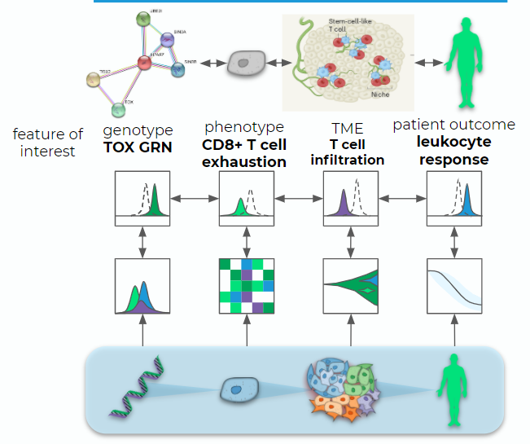
Cancer Cell Model
Multi-level model of cancer growth:
Separate multiscale complexity of cancer model describing specific sub-behaviours.
For example, a specific model of how a cell with a specific genetic or epigenetic profiles responds to treatment.

Slide 35
Cancer Tumour Model
Multi-level model of cancer growth:
The dynamics of a tumour are then modeled as subpopulations of cells with their own genetic and cellular profiles.
This acts as a high level model that includes the interactions between these different cells.

Slide 36
Patient Outcome
Multi-level model of cancer growth:
The health of the patient is then governed by the dynamics of multiple tumours and their interactions with the patient.
This is another higher level model.
The major goal is to perform this analysis on samples of many patients creating a high dimensionality multi-level model.
A variety of datasets are used for this analysis, will detail in a moment.

Slide 37
Cosmology & Cancer
We began talking to ConcR about 1 year into PyAutoFit develop, saw obvious overlap:
Composition of multi-level models in a scalable way.
Customization in how the model is fitted.
Customization in how different datasets are fitted.
Same challenge in terms of big data, massively parallel computing.
However, a core feature was missing at the heart of ConcR’s modeling:
Ability to fit multi-level models in a way that can scale up to 100000+ parameters.
API for multi-level modeling was non-existent.

Slide 38
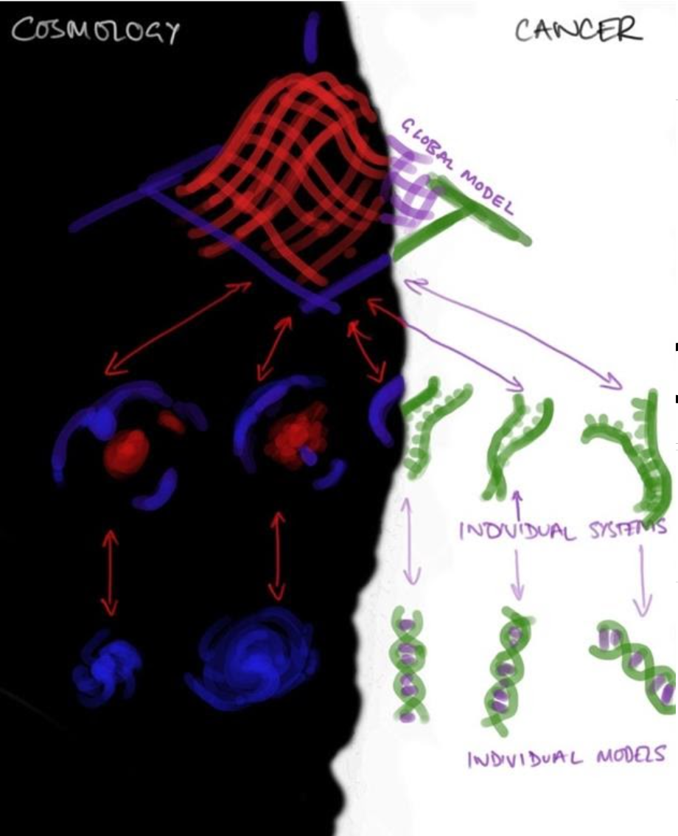

Slide 39
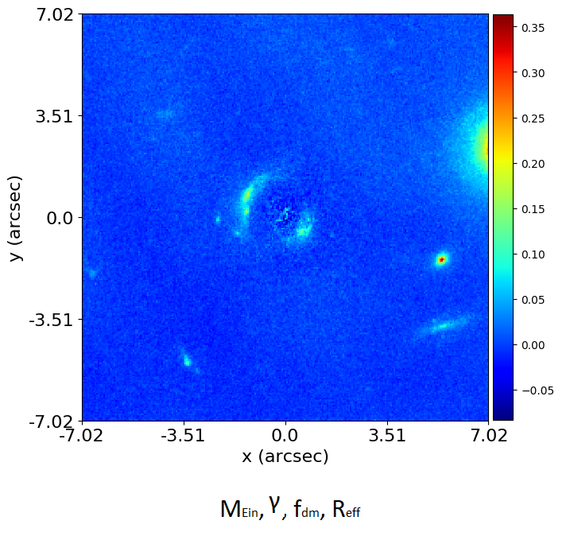
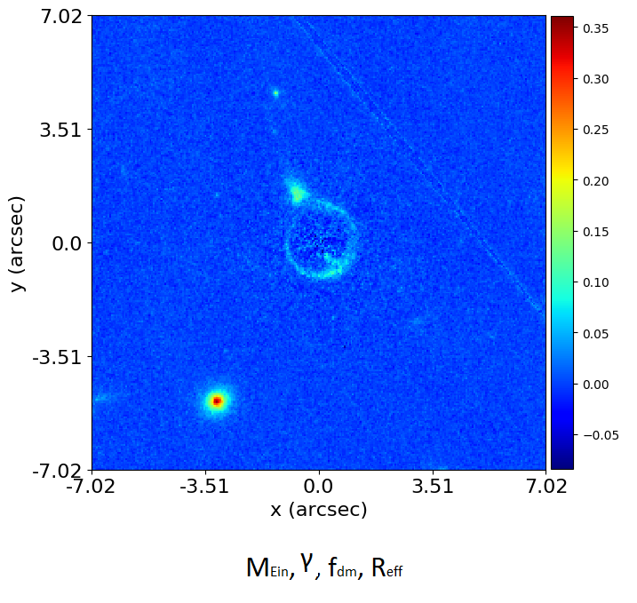
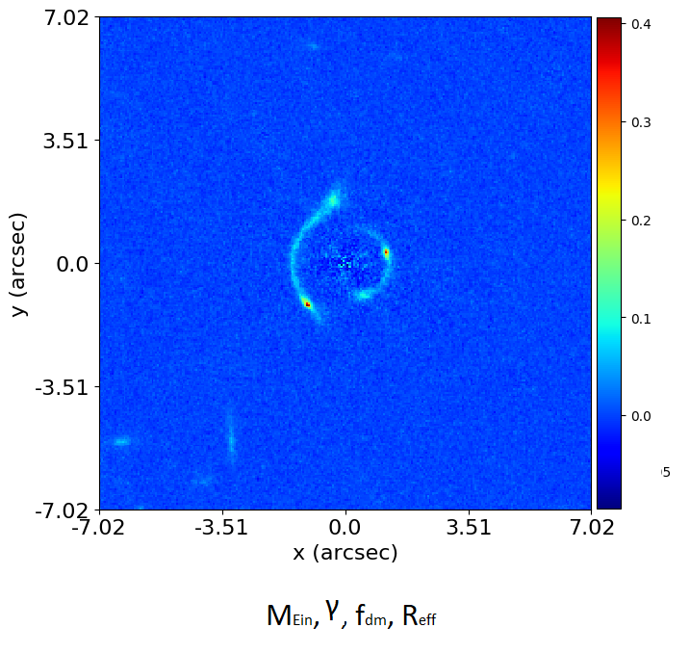
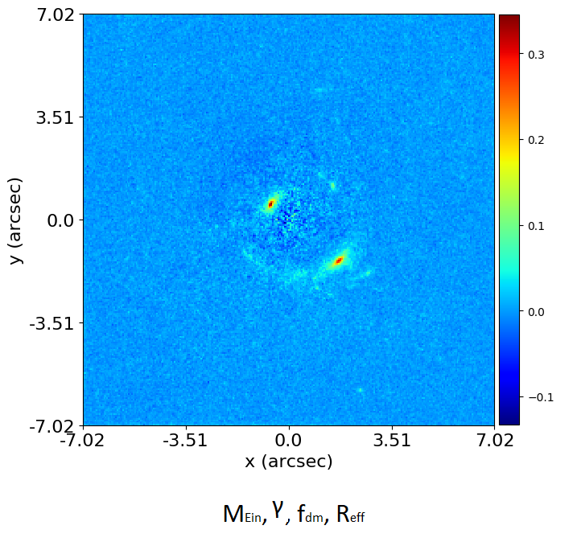
Strong Lens Modeling
The focus of my research was fitting individual strong lenses.
Turns this is a really hard problem, but one we have now solved.
Always knew we would need to fit thousands of lenses learn about galaxy formation and cosmology.
This requires a multi-level model.

Slide 40
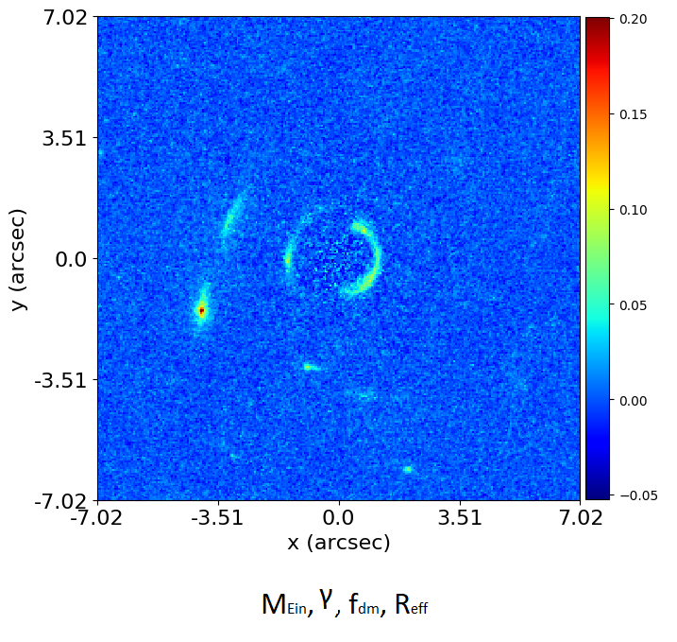
Graphical and Hierarchical Models

Slide 41
Expectation Propagation
Even with an API for composing multi-level models, how do we actually fit them?
Each dataset has 5+ data specific parameters.
For the problems we’re talking about, this could lead to models with 500000+ parameters.
Cannot fit using traditional non-linear search due to curse of dimensionality.

Slide 42
Expectation Propagation
Even with an API for composing multi-level models, how do we actually fit them?
Each dataset has 5+ data specific parameters.
For the problems we’re talking about, this could lead to models with 500000+ parameters.
Cannot fit using traditional non-linear search due to curse of dimensionality.
Building expectation propagation based model-fitting into graphical models (https://arxiv.org/abs/1412.4869).
Fits individual nodes of the graphical model, one-by-one, in parameter spaces of reduced dimensionality.
Pass information ‘up’ and ‘down’ scouring the model graph, working our way up to the high-level model components.

Slide 43
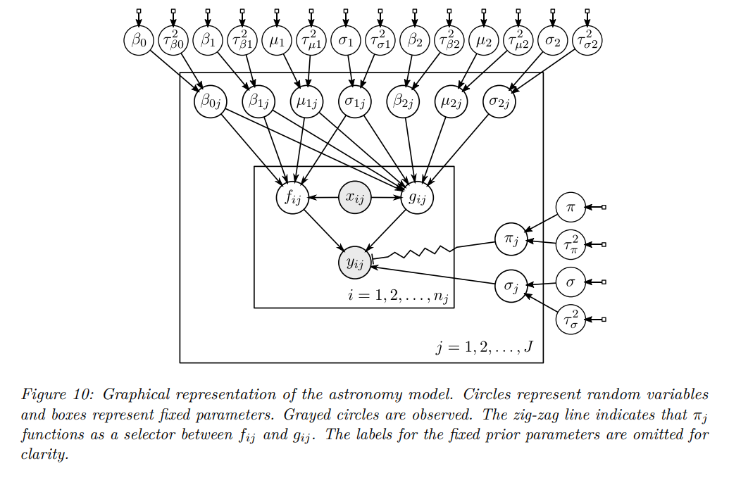
Example Graphical Model

Slide 44
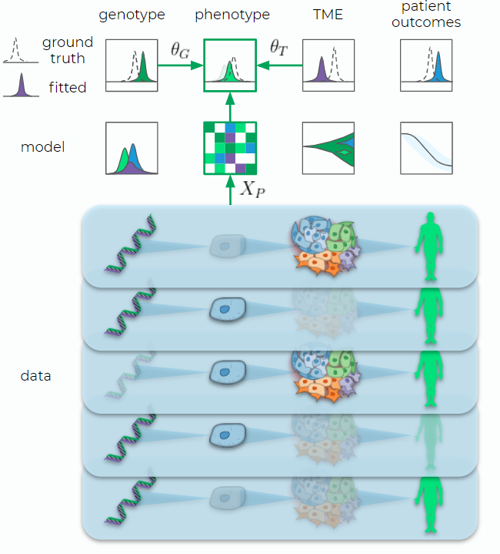
Cancer Datasets
Many different types of data are fitted:
genomic sequencing, cellular imaging, radioimaging, health outcomes, clinical trial data, etc.
On the ‘good side’ of quality / homogeneity for health datasets (no reliance on doctor’s scribbles).
A core selling point of ConcR, via the graphical modeling, is that it can account for missing data.

Slide 45
Summary
The statistical techniques used to understand the Universe’s Cosmology can be applied to studies of Cancer.
PyAutoFit is an open source project with scope way beyond just studies by Astronomers and healthcare scientists!
GitHub: https://github.com/Jammy2211/PyAutoLens Readthedocs: https://pyautolens.readthedocs.io/en/latest/ JOSS paper: https://joss.theoj.org/papers/10.21105/joss.02550 Binder: https://mybinder.org/v2/gh/Jammy2211/autofit_workspace/HEAD

Slide 46
PyAutoFit: A PPL for Astronomers
The interface of other PPLs is designed for topological models, integrating functions, thermodynamic parameter spaces, etc. - Great for statisticians, theorists and those with a certain types of model-fitting problems. - Not so great for those with more data focused model-fitting problems.

Slide 47
PyAutoFit: Advanced
Features

Slide 48
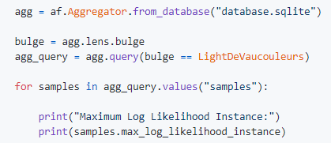
Database
Results of many model fits are output in an sqlite relational database:
Allocated a unique identifier based on the model-fit, such that you can trivially fit many models.
Database supports advanced queries (e.g. find all results, where this parameter is in this range).
Results use memory-light Python generators.
You can therefore fit (very) large datasets on a HPC and access the results efficiently via a Jupyter notebook.

Slide 49
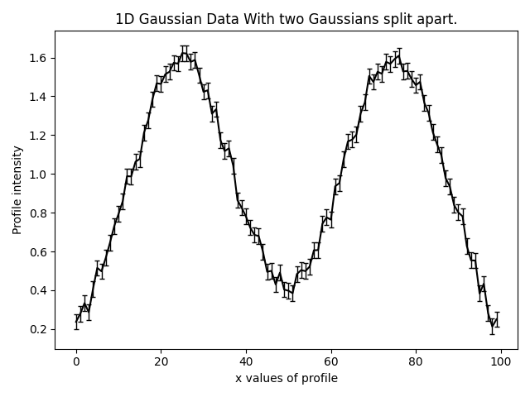
Search Chaining
Break a model-fit into a chained sequence of searches:

Slide 50
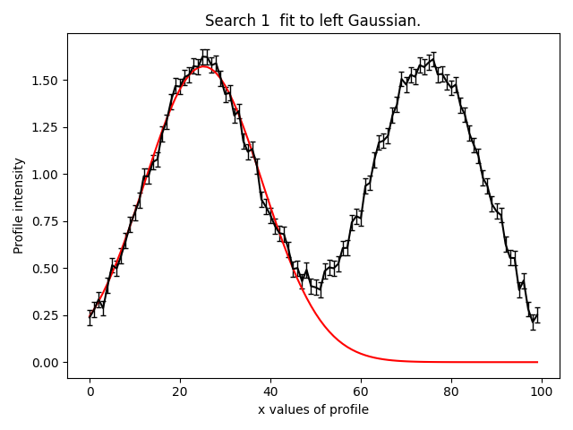
Search Chaining
Break a model-fit into a chained sequence of searches:
Search 1: fit model to left Gaussian with fast non-linear search.

Slide 51
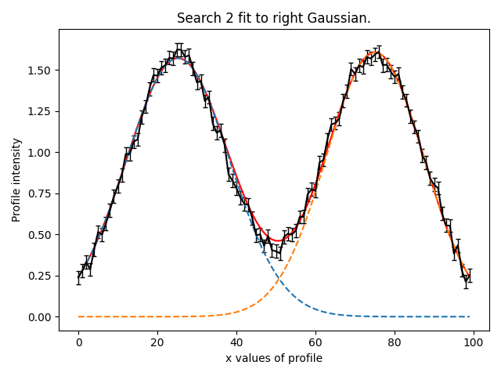
Search Chaining
Break a model-fit into a chained sequence of searches:
Search 1: fit model to left Gaussian with fast non-linear search.
Search 2: fit model to right Gaussian with fast non-linear search and result of search 1.

Slide 52
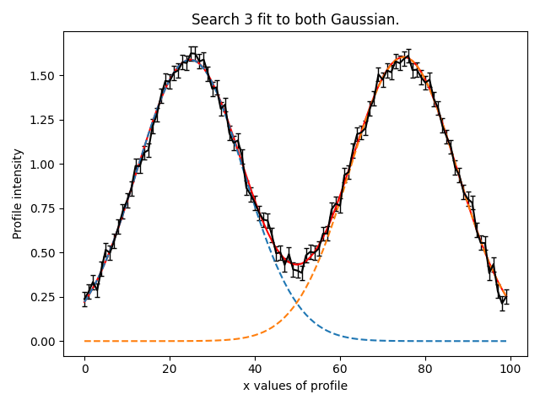
Search Chaining
Break a model-fit into a chained sequence of searches:
Search 1: fit model to left Gaussian with fast non-linear search.
Search 2: fit model to right Gaussian with fast non-linear search and result of search 1.
Search 3: Fit both Gaussians simultaneously with thorough non-linear search and a parameter space starting point inferred from first two searches.

Slide 53
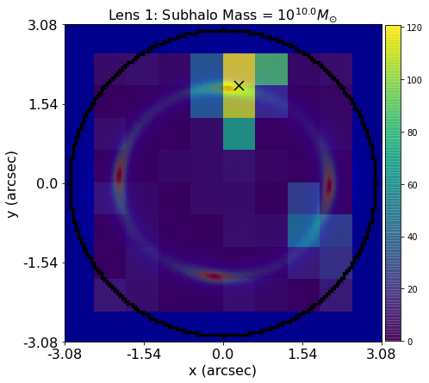
Grid Search of Non-linear Searches
Break a model-fit into a grid search of searches:
Support for massively parallel fits.
Database provides tools for analysing results efficiently.

Slide 54
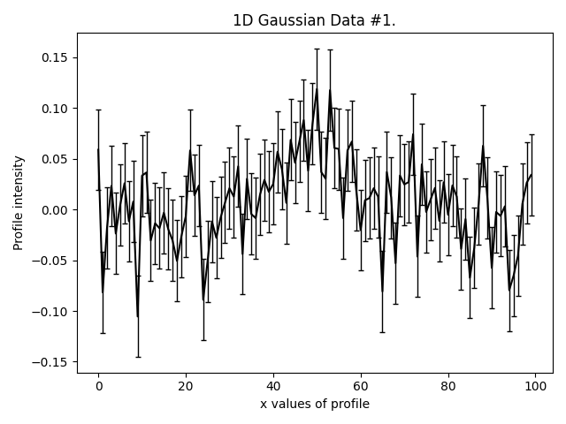
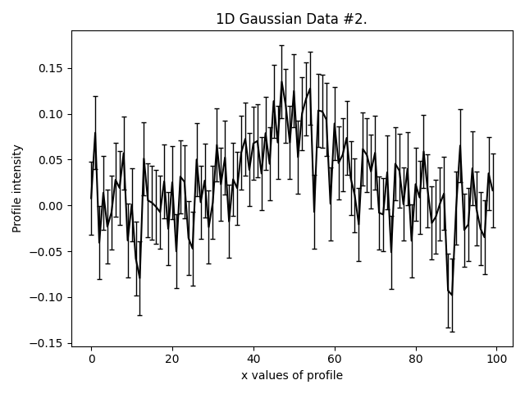
Graphical and Hierarchical Models
Compose multi-level models for fitting many datasets:
Simple example of fitting three low signal to noise Gaussians simultaneously.
Can assume all three Gaussians have same centre, but different intensity / sigma.

Slide 55
Graphical and Hierarchical Models
Can set up unique Analysis class, which will pair every dataset with components of the multi-level model:
Model is built out of individual model components like before.

